Slide 1
REST – REpresentational State Transfer

Slide 2
Agenda
Introduction
Main Entities
Concepts
Architecture Style
REST Verbs
Versioning Strategy
HTTP Status Codes
API Gateway
REST In Command Center
REST In Application Manager

Slide 3
Introduction
Representational state transfer (REST) is a software architectural style that describes the architecture of the Web. It was derived from the following constraints:
Client-server communication
Stateless communication
Caching
Uniform interface
Layered system
Code on demand
A system that complies with some or all of these constraints is loosely referred to as RESTful.
REST Representational State Transfer.
First introduced by Roy Feilding in the year 2000.
RESTful web services, as the name suggests, are resources on the web that can be used to get specific information.
In REST architecture, a REST Server simply provides access to the resources and REST Client accesses and modify resources.
State less, Client-Server communication protocol.

Slide 4
Introduction
Why is it called Representational State Transfer ?
It means that a server will respond with the representation of a resource (today, it will most often be an HTML, XML or JSON document) and that resource will contain hypermedia links that can be followed to make the state of the system change. Any such request will in turn receive the representation of a resource, and so on.
"Representational State Transfer is intended to evoke an image of how a well-designed Web application behaves: a network of web pages (a virtual state-machine), where the user progresses through an application by selecting links (state transitions), resulting in the next page (representing the next state of the application) being transferred to the user and rendered for their use."
http://weather.example.com/oaxaca
Server
Client
OaxacaWeather.html

Slide 5
Main entities
Client
Server

Slide 6
Basic concepts
The client requests a resource from the server and the server sends back the response (if there are no errors).
The response is itself a representation of the resource present on the server. For example, it could be a JSON, XML etc. This clarifies why the service is representational.
REST is stateless. It simply means that all the information that the server needs to give the response is supplied with the request itself.
Requests are generally in the form of URLs (Uniform Resource Locator). URLs are used to locate the path to a resource on the web server.

Slide 7
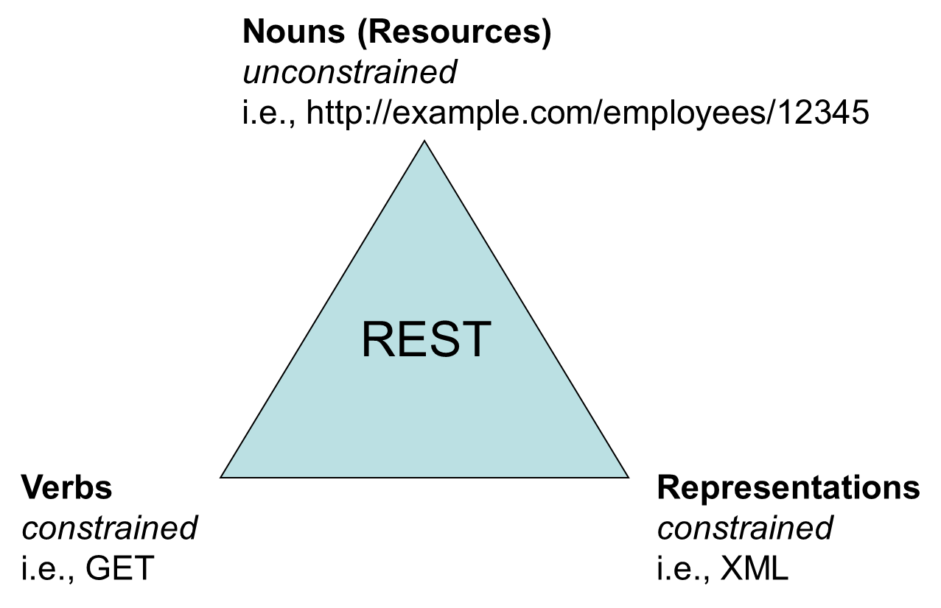
Main Concept

Slide 8
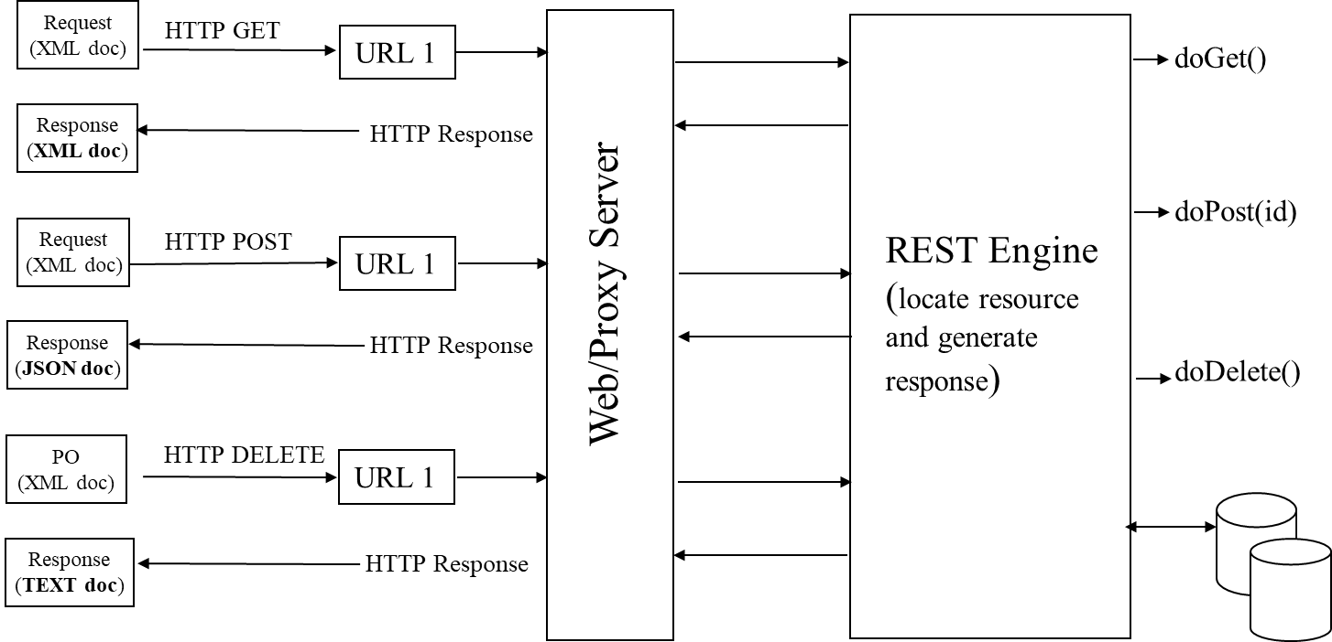
Architecture Style

Slide 9
Verbs
REST verbs specify an action to be performed on a specific resource or a collection of resources
A trivial REST API URI: http://HostName/API endpoint/Query(optional)
GET: GET method fetches the given resource from the server. To specify a -resource, GET uses a few types of URI queries:
Query parameters (/v1/books/?category=fiction&publish_date=2023)
Path-based parameter (/v1/payments/billing-agreements/agreement_id.)
Path vs Query parameters- It is a common rule of thumb that Query parameters are used to fetch multiple resources based on the query parameters. If a client needs a single resource with exact URI information, it can use Path parameters to specify the resource

Slide 10
Verbs
POST: The POST method is used to create a resource on the server.A successful POST operation returns a 201-status code. The POST request can update multiple resources: /v1/books
The POST request has a body like this:
{"name" : "Lord of the rings", "year": 1954, "author" : "J. R. R. Tolkien"}
This creates a new book in the database. An ID is assigned to this record so that when we GET the resource, the URL is created
PUT : The PUT method is similar to POST. It is used to replace the resource that already exists.
Request looks like - /v1/books/1256
Body- {"name" : "Lord of the rings", "year": 1955, "author" : "J. R. R. Tolkien"}

Slide 11
Verbs
Patch:
Did you observe the drawback of PUT? It replaced the entire old record with the new one. We needed to change a single column. But PUT replaced the whole record. That is bad. For this reason, the PATCH request was introduced.
Request looks like - /v1/books/1256
Body- { "year": 1955 }
Delete: The DELETE API method is used to delete a resource from the database. It is similar to PUT but without any body.
Options: Given the resource, this method tries to know all possible methods (GET, POST, and so on) defined on the server.

Slide 12
HTTP Status Codes
2xx Status codes indicate success. The most common status code is 200, OK.
3xx Status codes indicate that the client needs to do something else to complete the request. Usually this means making the request from a different location. Status code 301 means the resource has been permanently moved somewhere else.
4xx Status codes indicate a client error. That is, the client sent a request that did not make sense.
A classic example of this is “404 Not Found”. Try it! Go to https://www.google.com/bad its report the code 404.
5xx Status codes indicate a server error. That means that the request made by the client appears to be fine. But the server is experiencing some difficulty.
A server experiencing some difficulty might report “500 Internal server error”

Slide 13
Quiz
Which Error code should be applicable in case of unauthorized user?
A – 204
B – 401
C - 404
D - 503
Answer B

Slide 14
Versioning Strategy
A versioning strategy allows clients to continue using the existing REST API and migrate their applications to the newer API when they are ready.
URI Path -
One way to version a REST API is to include the version number in the URI path
This solution often uses URI routing to point to a specific version of the API
Example: http://www.example.com/api/v1/products

Slide 15
Versioning Strategy
Query Parameter
REST API is to include the version number as a query parameter.
This is a straightforward way of versioning an API from an implementation point of view.
Query parameters are more difficult to use for routing requests to the proper API version.
Example : http://www.example.com/api/products?version=v1

Slide 16
Versioning Strategy
Custom Header
REST APIs can also be versioned by providing custom headers with the version number included as an attribute
It requires custom headers.
curl -H “Accepts-version: 1.0” http://www.example.com/api/products

Slide 17
Versioning Strategy
Content- Negotiation
This approach allows us to version a single resource representation instead of versioning the entire API which gives us a more granular control over versioning.
Requiring HTTP headers with media types makes it more difficult to test and explore the API using a browser.
GET /users/3 HTTP/1.1
Accept: application/vnd.myname.v2+json
HTTP/1.1 200 OK
Content-Type: application/vnd.myname.v2+json
{
"user": {
"firstname": "John",
"lastname": "Smith",
"amount": "300"
}
}

Slide 18
API Gateway
API Gateway acts as a "front door" for applications to access data, business logic, or functionality from your backend services.
An API gateway is a software pattern that sits in front of an application programming interface (API) or group of microservices, to facilitate requests and delivery of data and services.
An API gateway takes all API calls from clients, then routes them to the appropriate microservice with request routing, composition, and protocol translation.

Slide 19
Ocelot
Ocelot is a .NET API Gateway.
https://github.com/ThreeMammals/Ocelot
https://github.com/ThreeMammals/Ocelot#features

Slide 20
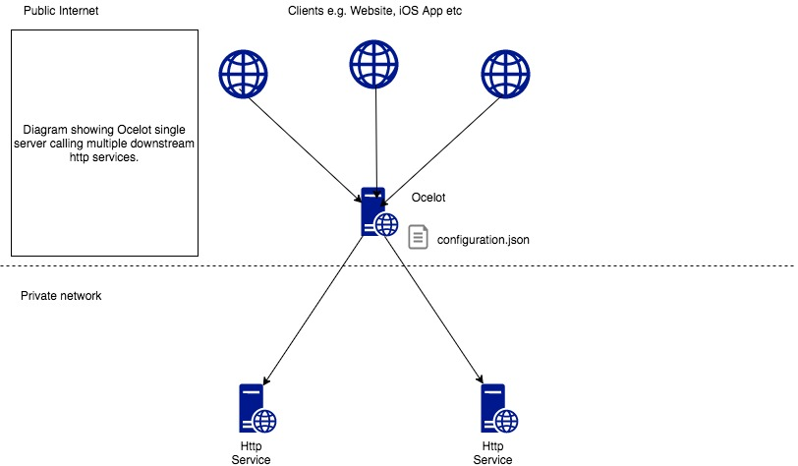
Ocelot – Basic Implementation

Slide 21
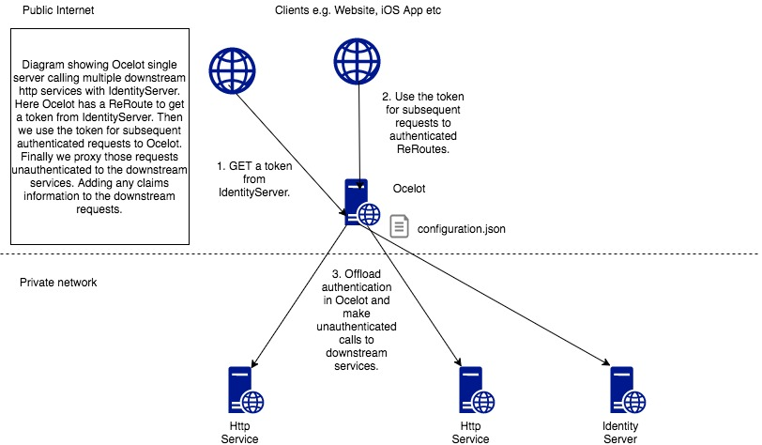
Ocelot – With IdentityServer

Slide 22
Where REST is used In Our Product?

Slide 23
Command Center & App Manager
Command Center
https://wiki.landisgyr.net/display/SRCC/Deployment+View#DeploymentView-8.5
App Manager
https://wiki.landisgyr.net/display/SRCC/Application+Manager+-+Deployment#ApplicationManagerDeployment-2022.2(CC8.5)

Slide 24
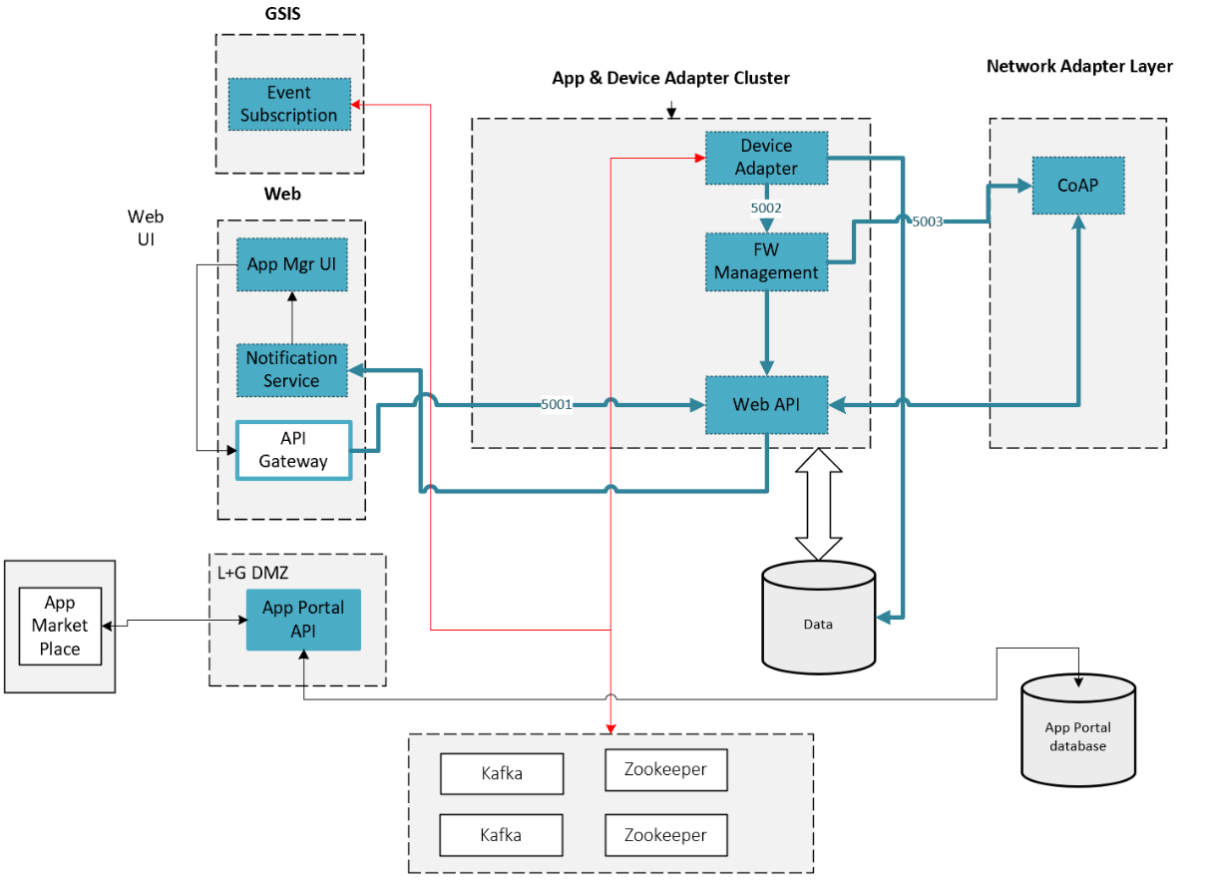
App Manager

Slide 25
Thank You

